Slide 1

PRACTICAL WORKS IN Business intelligence
OCTOBER 2021

Slide 2
1) WHAT IS business intelligence ?

Slide 3

DATABASES AND THEIR USES
The first role of database managing systems (DBMS) in business is to ensure recording and updating the data the company needs for its activity: orders, invoices, deliveries, payroll, etc. This is the management of operational data ; this role usually performed by classical R/DBMS : Oracle, Microsoft SQL Server, IBM DB2, MySQL, etc.
Accumulation of data in DBMS allows to address a second need : not only managing the activity, but also analyzing it.
This re-use of data is called ‘Business Intelligence’. A former phrase for this activity was ‘Decision Support Systems’, as analysis is supposed to help decision-makers.
Operational System
BI system

Slide 4
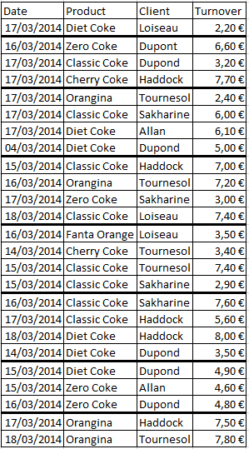
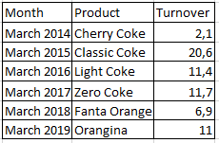
Aggregation
Sales detail
Sales
Aggregated sales by month and product
Sum by aggregation
Sales
Σ
In SQL :
SELECT Month, Product, SUM(Sales)
FROM …
GROUP BY Month, Product

Slide 5
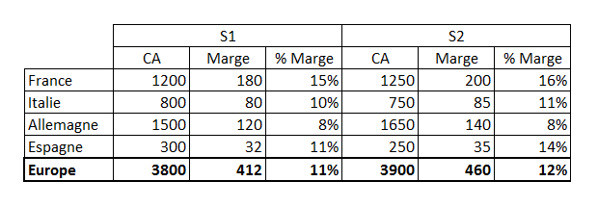
Dimensions VS MEASURES
Measures are the figures you want to measure. They have to be numeric and aggregable. In SQL, basic measures get an aggregation function.
Dimensions are qualitative information forming the context for the measures. In SQL, dimensions go to the GROUP BY clause.
Dimensions
Measures
Sales and Margin : basic measures
% Marge : derived measure, formula is SUM(Margin) / SUM(Sales)

Slide 6
2) The BI system

Slide 7
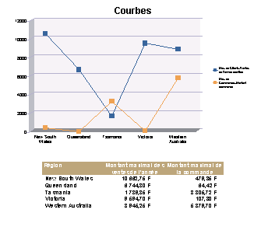

BIS ARCHITECTURE
Reports
Raw data (operational)
BI platform
Transformed data (analytical)
Reporting
Semantic layer
Ad Hoc Analysis
OLAP
Cube
DM
DM
What-If
Analysis
ERPs, Business Apps…
ETL
AGGREGATION
ETL
ETL
Production DBs
ETL
Infocenter (DWh)
ODS
Operational System
BI System

Slide 8
3) STAR SCHEMA

Slide 9
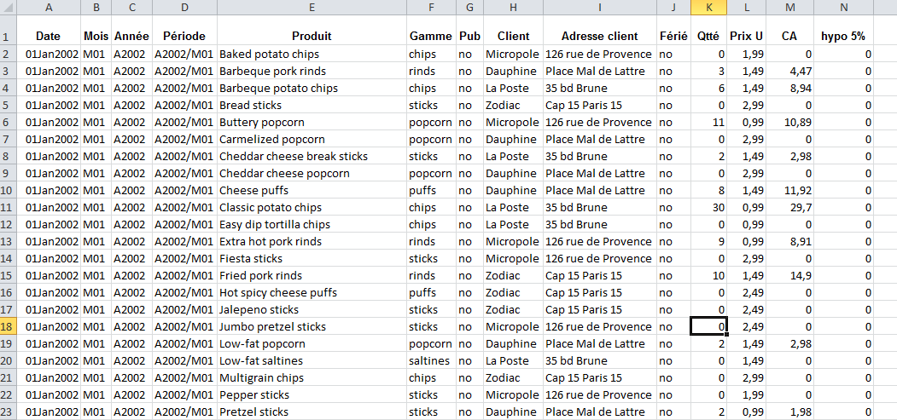
USER NEED : single table
The aim is to show a single table to the user…
… but without storing it on disks!

Slide 10
STAR SCHEMA
PRODUCT
Product ID
Name
Product Line
Product Manager
Color
...
SUPPLIER
Supplier ID
Name
Type
Nationality
...
SALES
Product ID
Supplier ID
Date
Cust ID
Turnover
Margin
...
TIME
dd-mm-yyyy
day-week
week-month
week-trimester
week-year
month
CUSTOMER
Cust ID
Name
Adress
Telephone
Region
...

Slide 11
SNOWFLAKE SCHEMA
PROD MANAGER
Prod Mgr ID
First Name
Last Name
Civility
Type
Type ID
Name
PRODUCT
Product ID
Name
Prod Line ID
Color ID
Packaging
SUPPLIER
Supplier ID
Name
Type ID
Country ID
SALES
Product ID
Supplier ID
Date
Cust ID
Turnover
Margin
...
Country
Country ID
Name
PROD LINE
Prod Line ID
Name
Color
ID-color
Name
CUSTOMER
Cust ID
Name
Adresse
Telephone
Region ID
...
PERIOD
dd-mm-yyyy
code-day
ID-season
yyyy-mm
mm
Region
Region ID
Name

Slide 12
Physical schema: constellation
DM 2
Agg. facts
Agg. facts
DM 1
Detailed facts
Detailed facts
DWh

Slide 13
4) MODELING Dimensions

Slide 14
WHAT IS A HIERARCHICAL DIMENSION
Geographic dimension example :
World
Continent
Country
City
Agency
Europe
America
France
Germany
Mexico
…
Paris
Paris
Lyon
Frankfurt
…
Opéra Agency
Bercy Agency
Part-Dieu Agency

Slide 15
USUAL HIERARCHICAL DIMENSIONS
Organisation dimension:
Directions
Departements
Teams
Employees
Accounting dimension:
Accounting class
Sub-class
…
Analytics account
Product dimension :
Product types
Product lines
Product references
Colors, options

Slide 16
RAGGED HIERARCHY ExAmple
Company
IT
Comm’
Systems
Networks
Windows
Unix
IP
Phone
Security
Alan
Betty
Colin
Denis
Eric
Fanny
Guy
Harvey
Isa
Kim
Nico
Matt
Olive
Paula
Jean
Direction
Department
Team
Employee

Slide 17
PATCHING UP THE hierarchY
Company
IT
Comm’
Systems
Networks
Windows
Unix
IP
Phone
Security
Alain
Betty
Colin
Denis
Eric
Fanny
Guy
Harvey
Isa
Kim
Nico
Matt
Olive
Paula
Jean
Comm’
Dept.
Comm’
Team
Direction
Department
Team
Employee

Slide 18
TIME MODELISATION EXAMPLES (1/2)
Simple hierarchical dimension:
Time
2015
2016
S1
S2
T1
T2
January
February
March
April
May
June
Oct.
S1
S2
T1
T2
January
February
March
T3
T4
July
Sept.
August
Nov.
Dec.

Slide 19
TIME MODELISATION EXAMPLES (1/2)
Simple hierarchical dimension :
Time
2015
2016
S1 2015
S2 2015
T1 2015
T2 2015
January 2015
February 2015
March 2015
April 2015
May 2015
June 2015
Oct. 2015
S1 2016
S2
T1 2016
T2 2016
January 2016
February 2016
March 2016
T3 2015
T4 2015
July 2015
Sept. 2015
August 2015
Nov. 2015
Dec. 2015

Slide 20
TIME MODELISATION EXAMPLES (1/2)
Double hierarchical dimensions :
Years
2015
2016
2014
Periods
S1
S2
T1
T2
January
February
March
April
May
June
Oct.
T3
T4
July
Sept.
August
Nov.
Dec.

Slide 21
TIME MODELISATION EXAMPLES (2/2)
Time dimension with parallel dimensions
Calendar year
Année civile
Année Mediamat
Evénements
Mediamat year
Events
January
Février
Bastille Day
Janvier
Février
Janv. Med.
Fév. Med.
Fête ciné
14 juillet
Med. Jan.
Med. Feb.
Film festival
1st
2nd
3rd
1er
2
3
S1 Med.
S2 Med.
20 juin
21 juin
22 juin
Med. S1
Med. S2
20th June
21st June
22nd June
31
1er
2
3
31st
1st
2nd
3rd
Civil year
Civil month
Dates
Mediamat year
Mediamat month
Mediamat week
Dates
Event year
Event
Dates

Slide 22
5) MODELING RULES

Slide 23
DIMENSIONALS MODELS: FOCUS ON FACTS TABLES
A relationship between all dimensions, with numeric properties, is materialized as a ‘fact table’; then, each dimension becomes a table (star) or one leaf-level table and its hierarchy tables (snowflake).
The fact table includes the facts to be analyzed and measured.
The facts table is usually a huge table, listing as many rows as actual combos exist.
The fact table weighs around 95 - 99% of total volume.

Slide 24
MODELING BY ANALYSIS OF REPORTS
Country
Label2
Client
Region
0,n
View 3
0,n
0,n
0,n
income
View1
0,n
Margin
Month2
Product
0,n
0,n
Day
Month
Channel
Range
0,n
0,n
View2
0,n
Sales
View4
Income
0,n
Label
0,n
0,n
Channel2
Trimester

Slide 25
CONTEXT : SOME PRINCIPLES
It can happen that all requests necessary can be integrated in a unique model (yet, it is not the most common case!)
A context including too many measures is unlikely to match a user's vision, and would be too complex for him.
Similarly, decent contexts include four to twelve dimensions ; a context with twenty or thirty dimensions would most likely be an modeling error.
The criterion to check whether the schema is valid:
The schema is correct if all possible queries produce sensible results.

Slide 26
THE RULES FOR STAR MODELING
Unicity: all the members of a dimension must have a unique name, allowing to recognize them without ambiguity.
Independance of dimensions: we assume dimensions are completely independant from each other (disregarding whether they actually are or not). Relationships between dimensions relies in facts only.
Combinatorial: user shall be able to mix all available members, even in an illogic way, and must not get error or absurd results.
Acyclicity: star (or snowflake) schema should not have any loop (coming up)
Consistency at leaf-level: measures should be defined at the lowest level of all dimensions (coming up)

Slide 27
Acyclicity
Queries on the star/snowflake schema will be generated by an automated tool, unable to make any choice.
Hence:
No view should include an alternative in table-to-table path,
No query should require a choice for a join,
The graph of each dimension should be acyclic.
Client
Client
Adress
Adress
Contract
Contract
Cyclic hierarchy
Acyclic hierarchy

Slide 28
SOLVING A LOOP BY ADDING A TABLE ALIAS
Cyclic hierarchy
Acyclic hierarchy
Often, the loop is due to entity with several roles…
… we cut the loop with table aliases or views

Slide 29
A E/R VEW OF BI MODELS
The E/R definition of a star schema :
Each dimension is an entity
These entities are cross-linked by an unique relationship that links them all
This relationship has attributes (measures) and will be materialized by the facts table
The E/R definition of a snowflake schema :
Each dimension is a set of hierarchized entities, with one as the leaf-level
Within a dimension, relationships are only 1-n with no attribute
The leaf-level entities from all dimensions share one relationship linking them all
This relationship is the only one with attributes; it will be materialized by the facts table

Slide 30

INDEPENDANCE of DIMENSIONs
We can see that the prohibition of direct links between dimensions can be found as early as the conceptual modeling stage, well upstream of the development of semantic layers.
More fundamentally, you never join the dimensions because you have to postulate dimensions are independant from each other. This is a major difference between normalized and BI modelings:
The operational vision aims at representing the real world, and thus to reproduce the complexity of associations between entities.
The analytical vision considers only two cases: either the two entities are completely dependant, i.e. hierarchical, or the two entities are assumed to be completely independent. This will allows us to analyze their real relationships through the data.
Cross case
Drinks
Sodas
Coke
Orangina
100%
Hierarchy
100%

Slide 31
Consistency at leaf-level
The leaf-level, or granular level, is the level of the dimension which is the most detailed one among those chosen for the model.
Thus, the granular level of a fact table or star model is the combination of the granular levels for all dimensions in the model.
Consistency at leaf-level states that all measures should be valued at the granular level of each dimension.
Technically, this rule implies that all measures are located on the facts table.
If measure cannot be valued at the leaf-level of a dimension, this measure and the dimension are incompatible.
Hence, they have to be separated in different star/snowflage schemas.

Slide 32
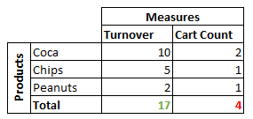
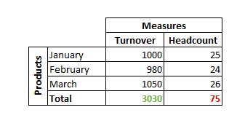
additivity
Basic measures should be additive on all the dimensions
... conversely, if this is not the case, the indicator and the dimension must be located in different datamarts, so that they are not confronted.
‘Stock measures’ are not additive on the Time dimension, but use other calculation rules.
Typical stock measures include
goods stocks, headcounts and
capital outstandings.

Slide 33
AGGREGATION ON TWO LEVELS
SUM
COUNT
Sum
Count
Sum
125
2
10
DISTINCT COUNT
AVERAGE
Weighted average
Sum
Distinct count
Average
24,5
20,8
8
7

Slide 34
POTENTIAL DRIFTS
Historicizing dimensions
Operational data are usually modeled with an instant view.
BI data should often be analyzed and modeled over long durations. This changes the cardinalities of relationships.
The attributes of each dimensional entity should be split into two groups:
Permanent properties: they can never change (at least in the analysis period), or we are not interested in tracking their changes.
Changing properties: they can change and we need to track these changes.
To analyze historicizing modes, Kimball has introduced the notion of Slowly Changing Dimension.
Designing a simple model is a complex task.

Slide 35
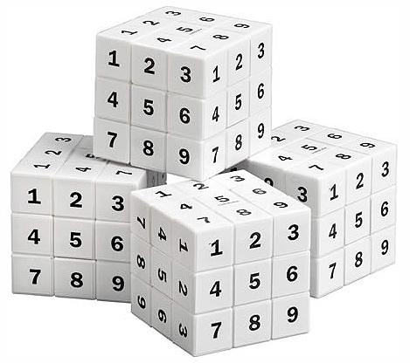
REfErences
Speaker :
Antoine Dinimant, BI architect
Personal webpage : http://antoun.developpez.com
E-mail : antoine@D6conseil.fr
Bibliography
Ralph KIMBALL, The datawarehouse toolkit
William INMON, Building the datawarehouse
Notes:
1

